Slide 1
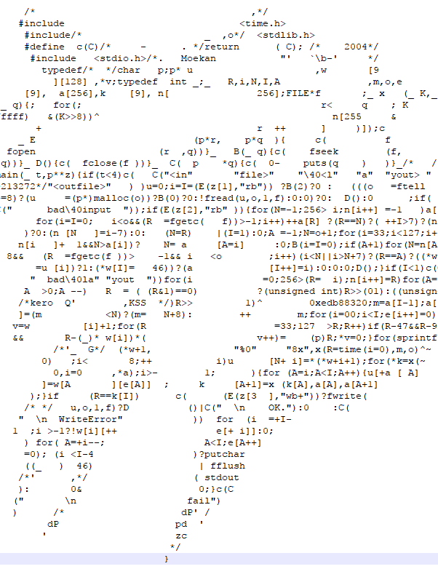
Code Style
Adam Sweeney
CS 211
Wichita State University, EECS

Slide 2
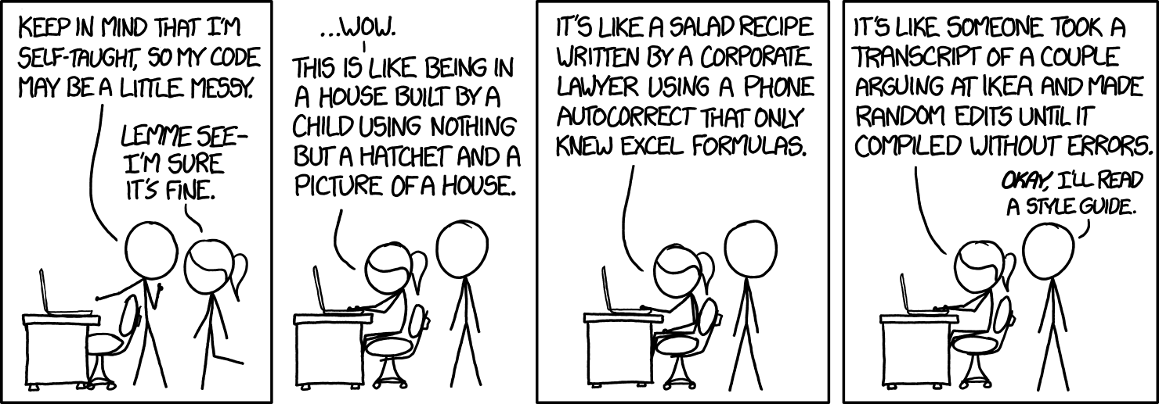
Introduction (relevant xkcd)
Notes:
Alt-text: I honestly didn’t think you could even USE emoji and as variable names or that there were so many crying ones.
Source: https://xkcd.com/1513

Slide 3
What is Style?
How the code looks
Code is hard to read
That of other people
Your own code a few months later
Your own code a couple hours later
It is important to write code that can be understood
There are some generally universal standards
Usually a few valid options to choose from

Slide 4
Why Style Matters
“Any fool can write code that a computer can understand. Good programmers write code that humans can understand.”
Martin Fowler, Refactoring: Improving the Design of Existing Code
Other people will see our code
We’ll see our code later
It’s extremely important that we write human-readable code

Slide 5
Basics

Slide 6
Indentation
Choose a size and stick with it
Acceptable sizes are 2, 4, or 8 columns
Recommend 4
Exclusively use one of tabs or spaces
Many editors have settings to insert spaces or tabs by pressing the tab
DO NOT MIX AND MATCH TABS AND SPACES
Indent only according to your “block-level”

Slide 7
Naming
Variables
Variables should be given a descriptive, succinct name, usually with an object word
Do NOT use Hungarian notation
Functions
Function names should be given a descriptive, succinct name, usually with an action word
Some of this changes with Object-Oriented Programming, but we’re not doing that

Slide 8
But Descriptive Names Are Long
Not always
tmp gets its point across just fine
But there will be times where a variable or function name requires more than one word
There are choices here
Lower camel case [lowerCamelCase] (my recommendation for variables)
Upper camel case [UpperCamelCase] (my OOP recommendation for types)
Lower snake case [my_function] (my recommendation for functions)
Upper snake case [My_Function]

Slide 9
Constants
Sometimes we need to work with a number that doesn’t change
We can “name” the number by assigning it to a variable
We also make the variable const, which means it cannot be altered
Constant
const int NUM_BRANCHES = 10;
All caps is a style recommendation to make constants easier to distinguish from regular variables

Slide 10
Brace Placement
There are many ways to do proper brace placement
This class will only consider the two presented as acceptable
if (expression) {
// do stuff
}
if (expression)
{
// do stuff
}
Notes:
Top method acceptable for if/else, switch, loops
Bottom method acceptable for if/else, switch, loops, and functions

Slide 11
Still with the Brace Placement
If you choose to place an open brace on its own line, nothing else goes on that line
The same goes for the closing brace, with a couple exceptions
if/else if blocks
do/while loops
if (expression) {
// do stuff
} else if (other expression) {
// do stuff
} else {
// do stuff
}
do {
// do stuff
} while (expression is true);
Notes:
That space before an opening brace or after a closing brace should not be considered optional

Slide 12
Types of Comments
Single line
statement; // Comment
// Comment
statement;
Multiline
/*
* Beginning of comment
* Comment body
* Last line of comment
*/
Notes:
For single line comments, if placing them to the right of your code, line groups up as best as possible

Slide 13
Writing Good Comments
Proper comments aids in the understanding of code
Overly verbose/frequent comments or spartan comments hurt readability
Comments should rarely discuss “what”, but should discuss “how” or “why” instead
”What” is generally plain to see when looking at the code

Slide 14
Other Tips

Slide 15
Loops
By default, your loop counter variable is i
When dealing with loops, you may choose something more descriptive, but keep it short
Ex. Nested loops for rows and columns
for (int row = 0; row < …) {
for (int col = 0; col < …) {
// do stuff
}
}
Notes:
A sure sign that your style is off are consecutive closing braces at the same indent level
In the case of a for loop, we will always declare our loop variable IN the loop unless we have a very good reason to do otherwise (usually we don’t)

Slide 16
Big if/else Blocks
Sometimes in big if/else blocks, each decision only needs to do one thing
Don’t have to use braces if you don’t need them
I recommend always using braces
If it’s good enough for John Carmack, it’s good enough for us
But if you need them in one branch, you need them in every branch
This is a block-by-block decision

Slide 17
Big if/else Example
if (check1)
// set var
else if (check2)
// set var
else if (check3) {
// set var
// do more stuff
} else
// set var
if (check1) {
// set var
} else if (check2) {
// set var
} else if (check3) {
// set var
// do more stuff
} else {
// set var
}

Slide 18
Logical Groups
This one is harder to quantify
Programs contain algorithms
An algorithm is a series of steps performed to complete a task
Each step can require multiple lines of code
Create some white space (one blank line, typically) between logical groups
When we discuss functions, one blank line between function implementations is an example
Notes:
Other example: In a program where we get user input, operate on the input, and return a result
group variable declarations, group get input, group operate on input (possible that this involves more than one group), group returning of data, group any cleanup

Slide 19
Consistency
The most important thing in code style is consistency
Where you have options, make a choice and stick with it
I encourage trying different styles, but make your choices on a per assignment basis

Slide 20
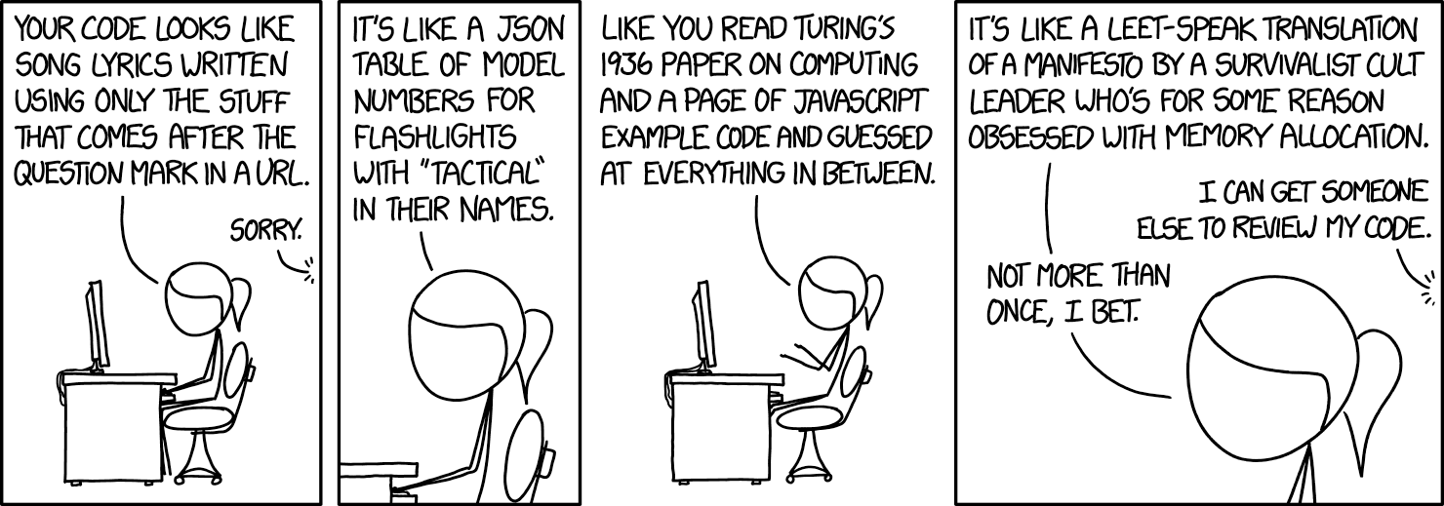
Reminder (relevant xkcd)
Notes:
Alt-text: It’s like a half-solved cryptogram where the solution is a piece of FORTH code written by someone who doesn’t know FORTH
Source: https://xkcd.com/1833/

